Slide 1
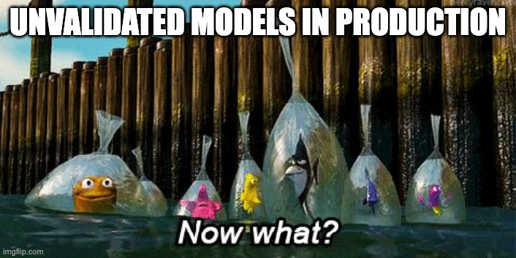
Data Drift and Beyond: Testing your Model and Data
Nadav Barak
ML Lead @ Deepchecks
Notes:
Thanks for inviting me to Huji, been a while…

Slide 2





About Me
About
Nadav Barak
~9 Years in Data Domains
Data Analysis
Math
Data Science
ML Lead @ Deepchecks
Founded 3 years ago
Continuous Validation for ML Systems
Open Source
Tabular, Computer Vision, NLP
Test Suites for Offline Validation
Production Monitoring & CI/CD
OPEN-SOURCE PACKAGE
DEEPCHECKS HUB
Notes:
Deepchecks mainly deals with testing and monitoring ML pipelines

Slide 3
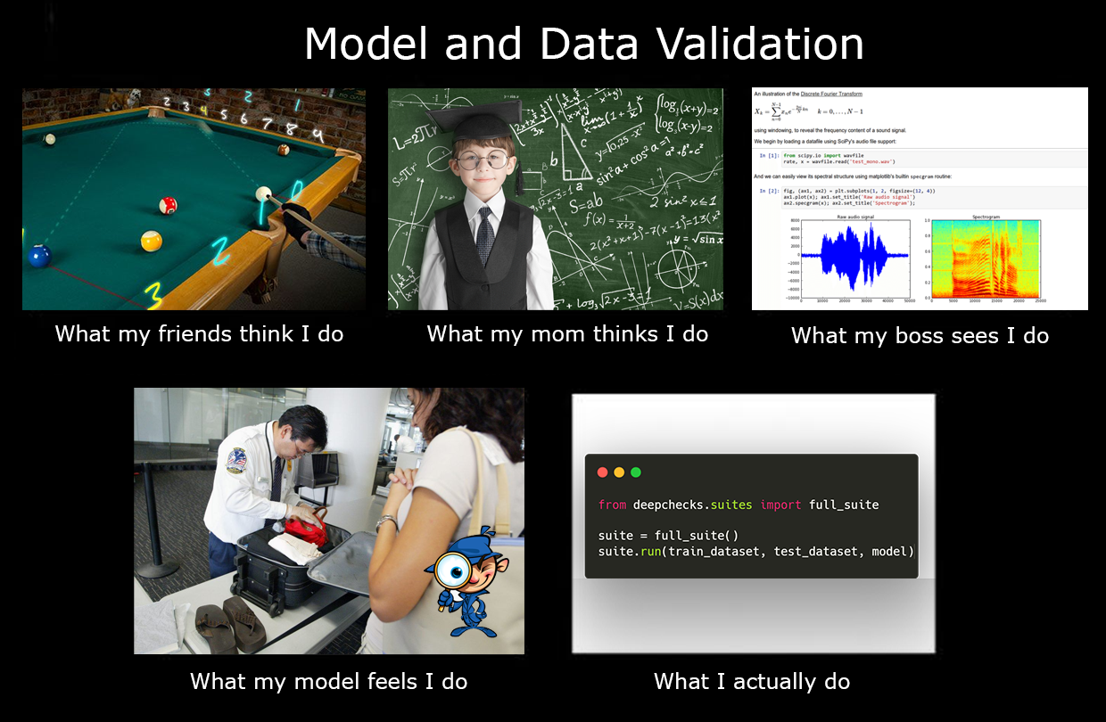
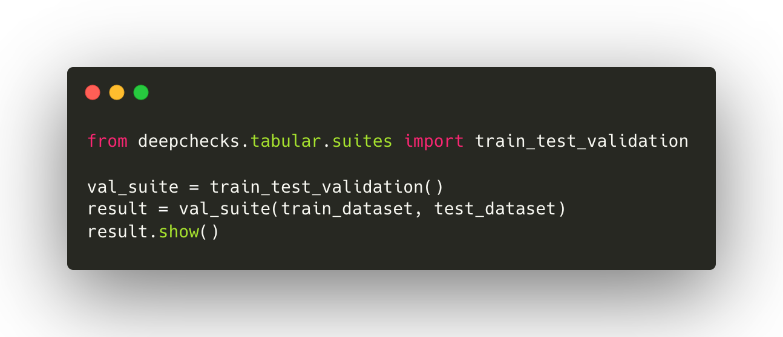
What will we talk about?
Testing ML
Challenges
Types of Problems
How, When & What to test for
What is drift, why is it important?
Structured data
Unstructured data
Drift mitigation
Hands-on – Deepchecks OSS
Notes:
We talked a bit about motivation,
Let’s look at an overview etc…

Slide 4



Testing Software
vs.
Testing ML
Changes
Can track code differences
Data, model & pipeline
may change
Coverage
Can account for code coverage
No clear “coverage” term
Silent Failures
Rare
Common
Notes:
Bugs
Surprises, Minimize the “unknowns”
Changes – a model can be retrained, data format can change, production pipelines can be updated and not reflected in training code or model artifacts
Coverage – code can be tested and % coverage tracked. For ML you can never know the scope of your model's behavior – test data metrics are only a initial proxy.
Silent failures – such as nans, leakage, drift. Model will still predict.

Slide 5
What Can Go Wrong?
Acquire Data
Define Train & Test
Evaluate

Slide 6

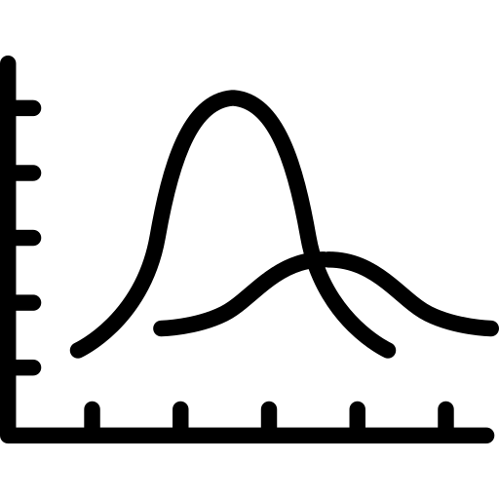
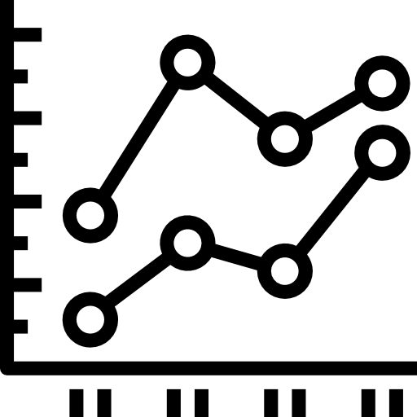
What Can Go Wrong?
Dirty Data
String Mismatch
Label Integrity
Feature Drift
Label Drift
Concept Drift
Performance Degradation
Weak Segments
Confidence
Data Integrity
Data Split
Model Behavior
Format Inconsistency
Sampling Manner
Anomalous
Data
Preprocessing Faults
Duplicates
Leakage
Fairness & Bias
Overfit
Calibration

Slide 7
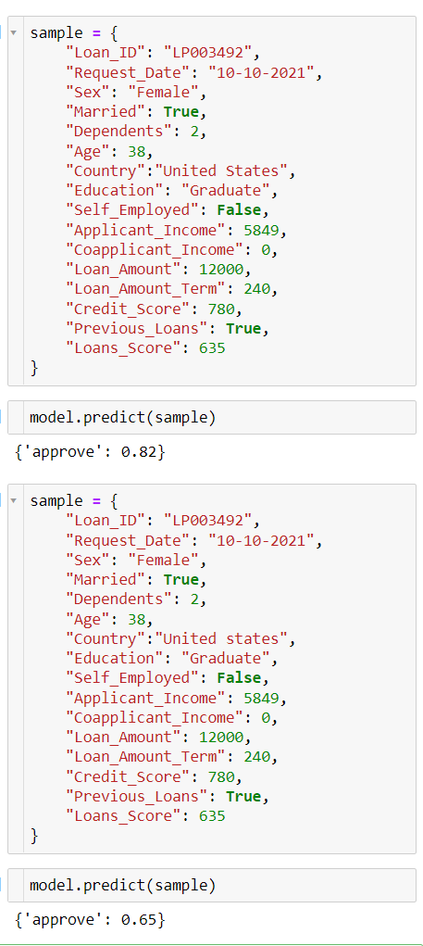
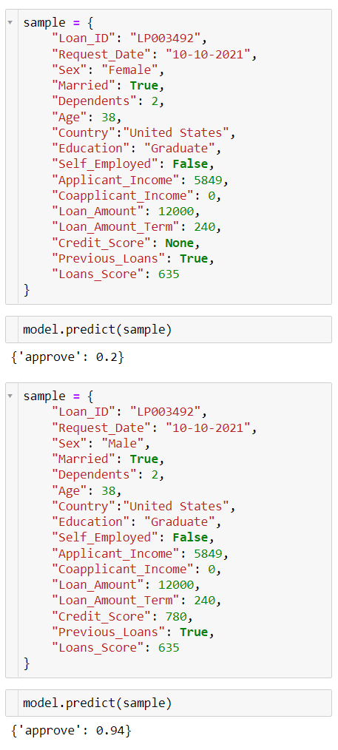
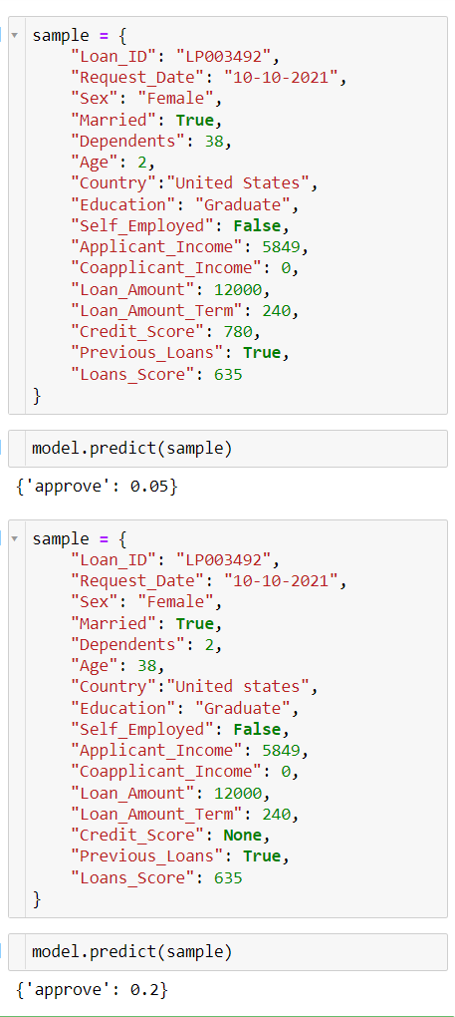
Tabular Examples
Preprocessing Faults
String Mismatch
Fairness & Bias

Slide 8
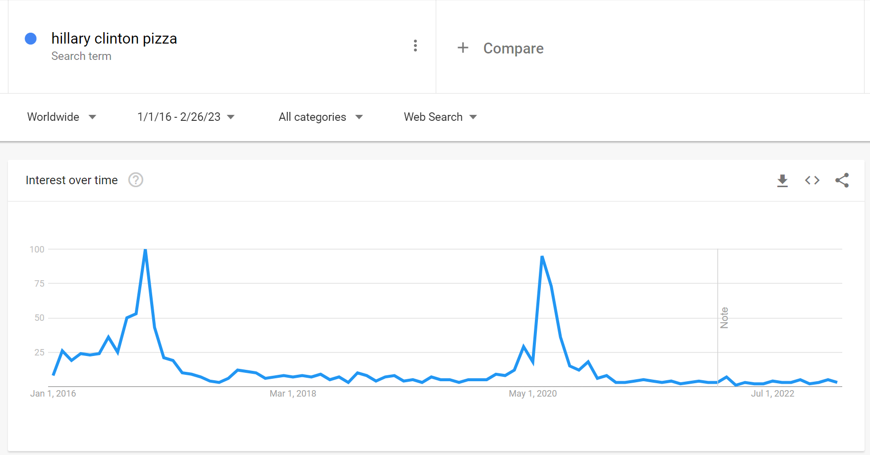


NLP Examples – Data & Concept Drift
Before 2016:
Pizza -> Good!
After 2016:
Pizza -> ???
2016 elections
TikTok 2020
Notes:
Ilustrate with an example that showcase why is it important
Model aiming to classify sentiment toward brands, specifically here toward hillary clinton
Concept Drift

Slide 9
NLP Examples – Shortcut Learning
“There is no scientific evidence supporting the claims made by NLP advocates, and it has been called a pseudoscience. Scientific reviews have shown that NLP is based on outdated metaphors of the brain's inner workings that are inconsistent with current neurological theory, and contain numerous factual errors. Reviews also found that research that favored NLP contained significant methodological flaws, and that there were three times as many studies of a much higher quality that failed to reproduce the "extraordinary claims" made by Bandler, Grinder, and other NLP practitioners.”
- Wikipedia
“NLP works!”
- My aunt
Long -> True
Short -> False
Notes:
Model fixate on simple properties of our unstructured data in order to make predictions
As example, Model to classify which argument is true

Slide 10


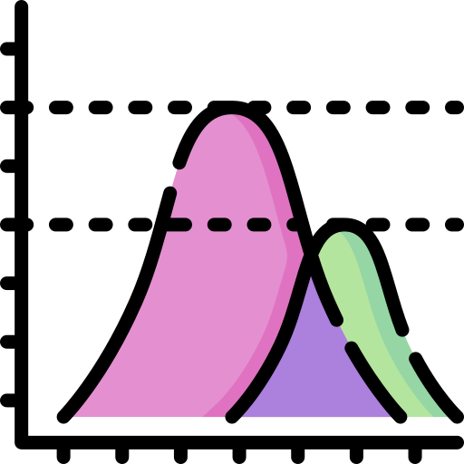
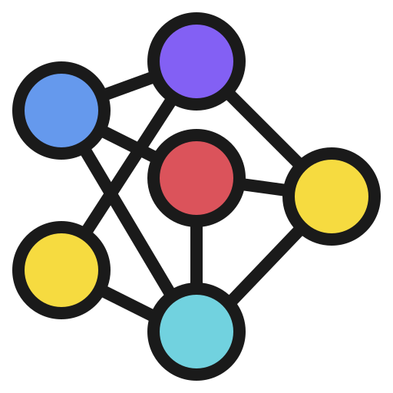
Checks
Data
Train / Test Split
Model
Types
Formats
Values
Relations
Distributions
Leakage
Metrics
Sanity
Robustness
Notes:
*Note here – high level, and possibly drill down later etc.
(run over this quickly)
Maybe – just make this a “takeaway slide” to go over…. Part of the checklist
Inspect Data
Data types & data format integrity (e.g. date formats, consistent naming schemes, consistent null types, special characters, string lengths)
Data values: ranges, null percentage, outliers
Leakage, sampling errors, labeling errors
Unexpected relations and correlations between features and/or between features and labels
Distribution of data and labels
Compare Data Batches
Meaningful changes in any of the above (data types, formats, values, different relations or correlations)
Feature drift or label drift

Slide 11
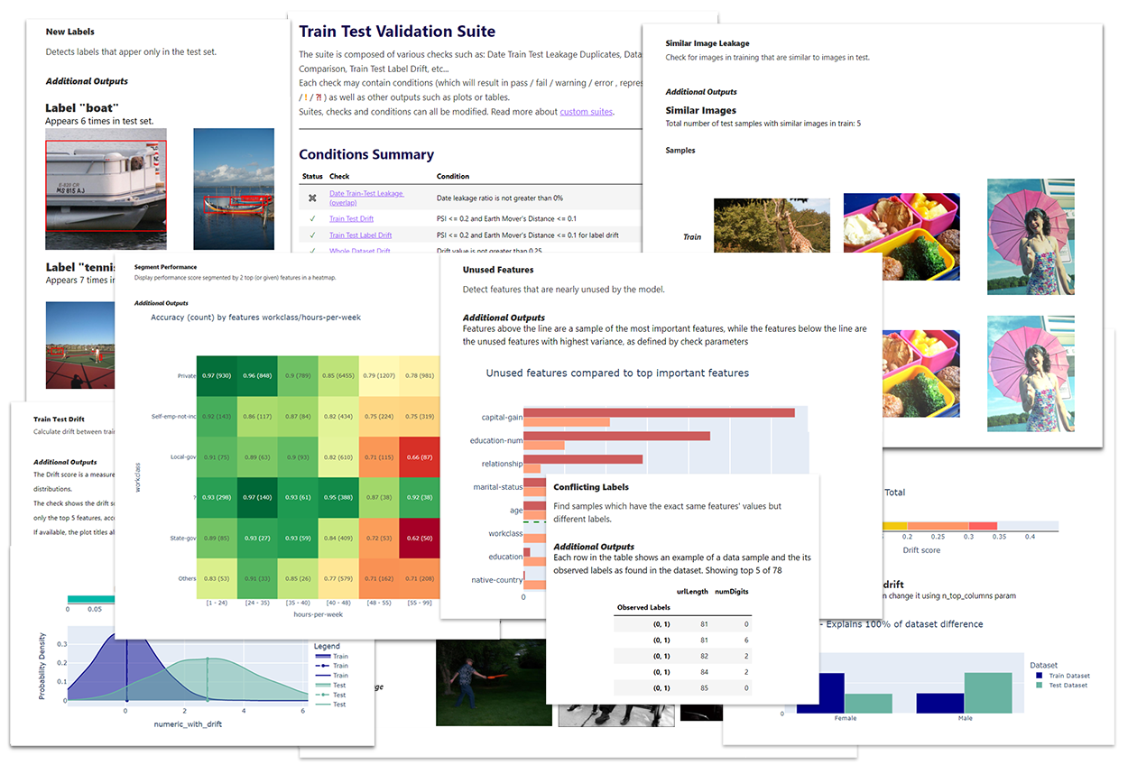

Deepchecks: Open Source for Testing ML
https://github.com/deepchecks/deepchecks
Notes:
Here ask Fatima to send the link to the bit.ly… (the google drive)
*Python environment.
Deepchecks philosophy – Out of the box, plug and play, visually inspectable tests, that are also extendable customizable.
What deepchecks doesn’t currently do – schema validation and behavioral testing. These are not “out of the box / plug and play” so they’ll be added in the future.

Slide 12



Validation Structure
Checks
Conditions
Test Suites
Display
and
Result
Pass / Fail / Warning
Built-in
or
Custom

Slide 13
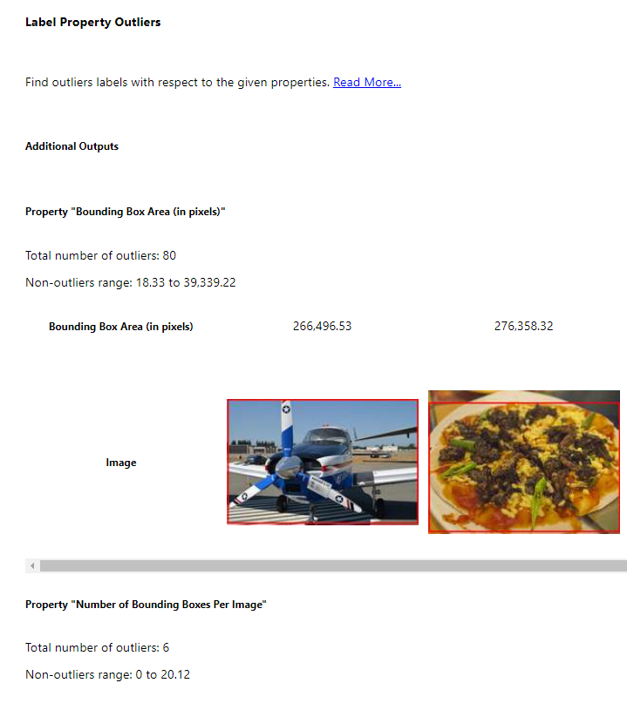
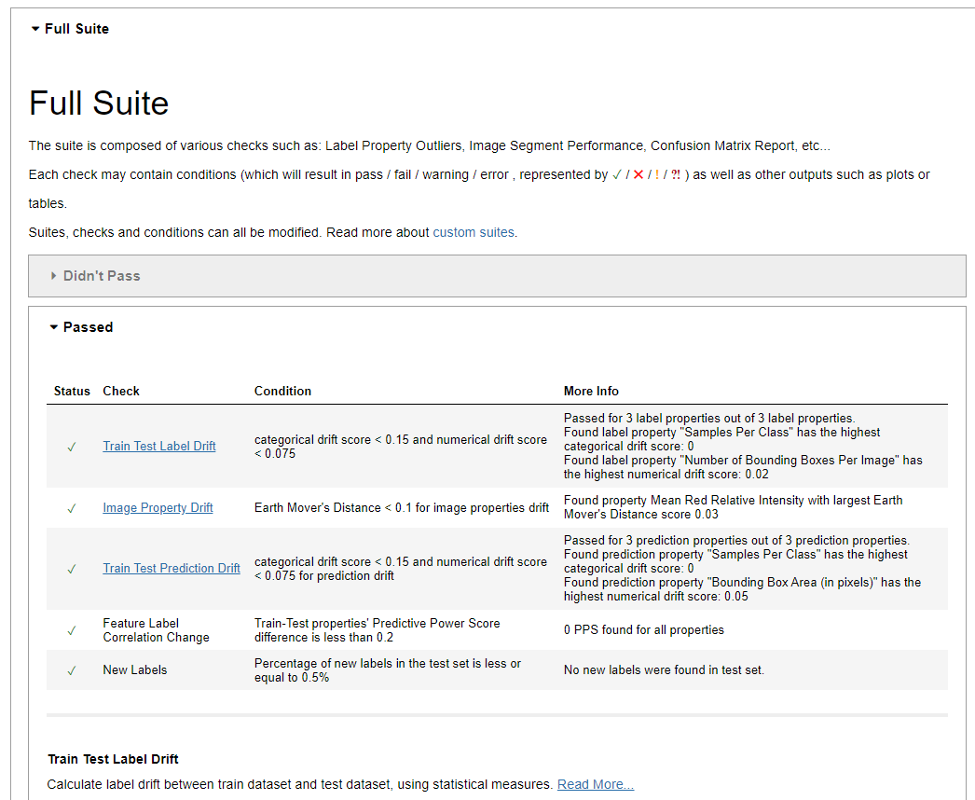
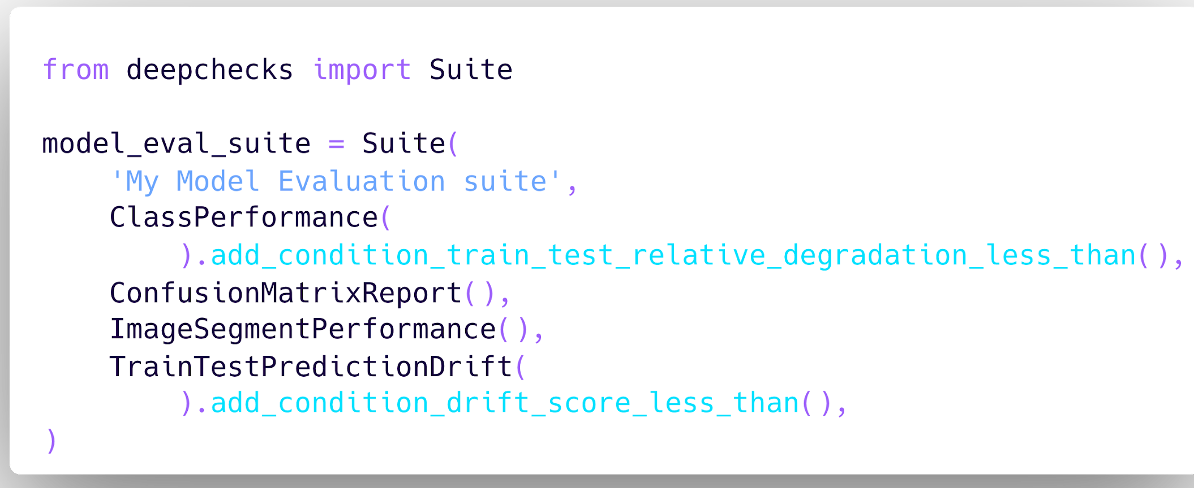
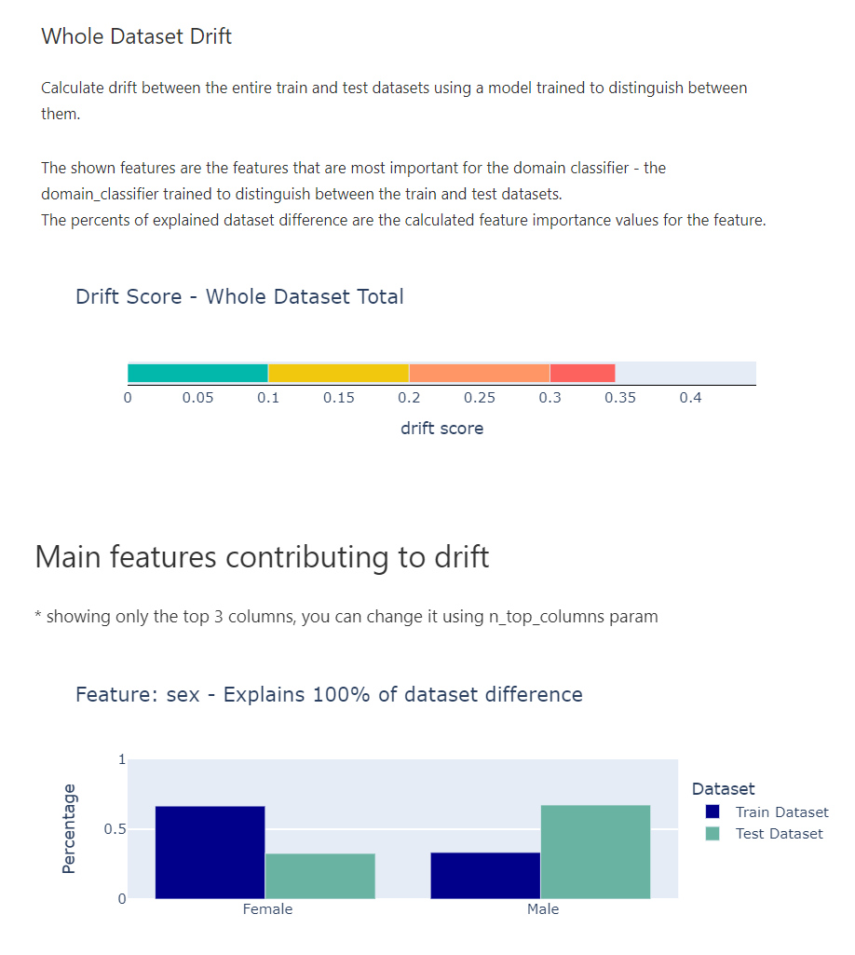
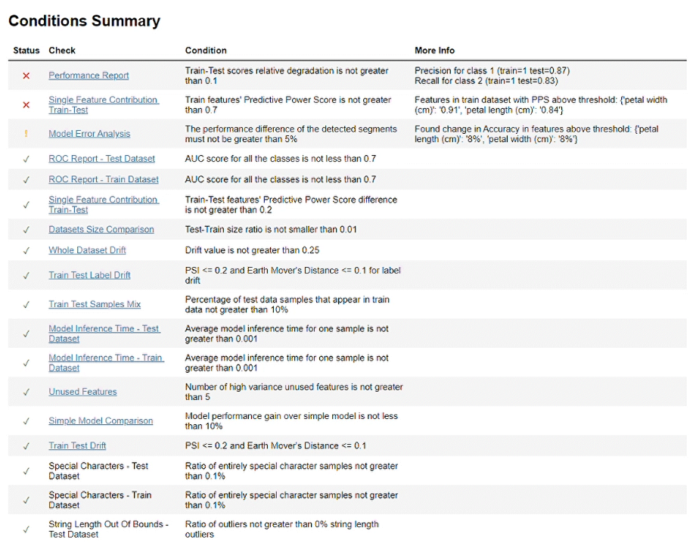
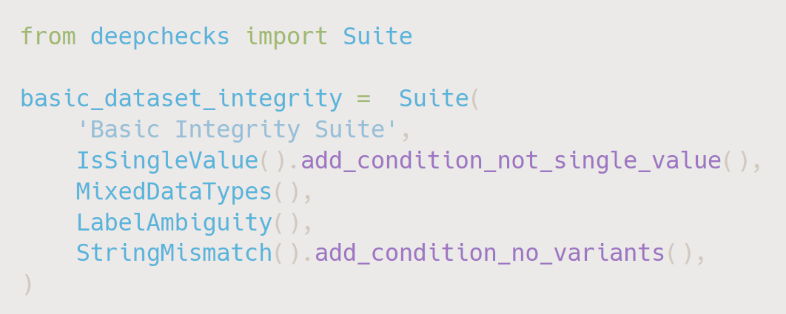
Validation with Deepchecks
Checks
Conditions
Test Suites
Pass / Fail / Warning

Slide 14






Built-in Suites
Research
CI / CD
Monitoring
Ingestion
Preprocessing
Training
Evaluation
Deployment
Production
Data Integrity
Train-Test Validation
Model Evaluation
Data
Batches
Model
Notes:
What time do I want to arrive here?
Research
Why? Avoid stupid mistakes, be efficient (find problems early, quicker comparison and validation iterations), increase confidence in model’s “real life performance”
When/what exactly?
First intro with data / split (validate on quick iterations – of data or e2e)
Problems that will make training less good (problematic data, balanced, leakages ….)
Will this model perform as good “in real life”, generalizaiton
CI / CD
Why? Automate and streamline process (be able to make it more frequent & efficient), increase trustability of new versions
When/what?
Manual / Automatic?
What do I need to know for that – comparison to current status quo (e.g. current model). Any bizarre pitfalls (e.g. different pre-processing pipelines, current training data was highly skewed in comparison to previous, different business needs or requirements .calibration, etc.).
Monitoring
Why? Detect changes that are going to affect performance ASAP
When/what?
Data integrity, drifts in data, distributions (also of predictions), changes in model’s confidence,
--
Typically tests are… ”once” (e.g. per unit, when the system itself is read, etc.) Here it’s a bit different…
CI / CD – “decision before deployment”… can be also manual
CONNECTION BETWEEN THEM (some of the tests / partial)
Research – static. Ci/cd – changes. Monitoring – over time.

Slide 15
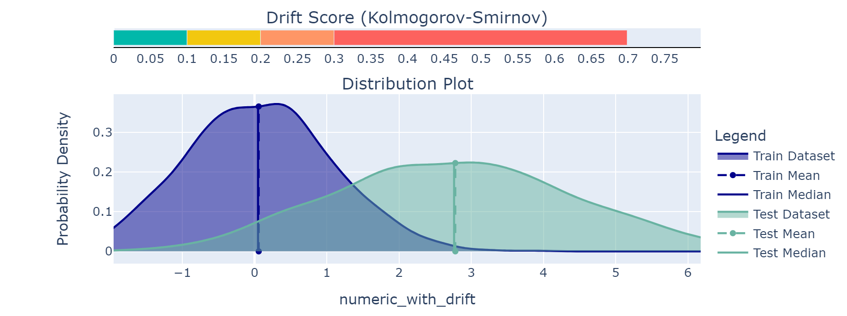
Data Drift
Notes:
Here ask Fatima to send the link to the bit.ly… (the google drive)
*Python environment.
Deepchecks philosophy – Out of the box, plug and play, visually inspectable tests, that are also extendable customizable.
What deepchecks doesn’t currently do – schema validation and behavioral testing. These are not “out of the box / plug and play” so they’ll be added in the future.

Slide 16
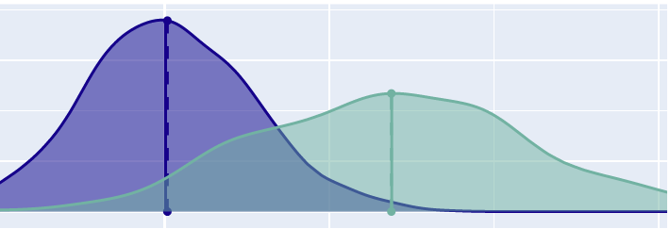
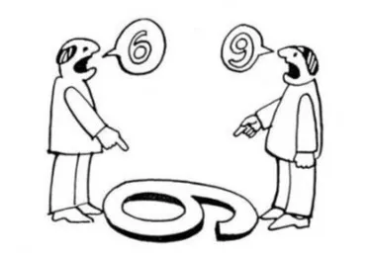
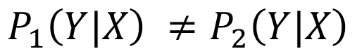
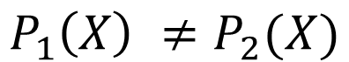
What is Drift?
Drift is a situation where the data, labels or their joint distribution changes over time.
Drift can be categorized into two broad categories:
Data Drift
Concept Drift
train
production
$$P_{1}\left(X\right) ≠P_{2}(X)$$
$$P_{1}\left(Y|X\right) ≠P_{2}\left(Y|X\right)$$
Notes:
Explain with an simple example - we are a company that buys and sells houses and have a model that get a house details and predicts its cost.
Data Drift: over time we get a lot more small apartments then before (less private houses, big apartments)
Concept Drift: Penthouse apartments become popular and the relative cost of them soars

Slide 17

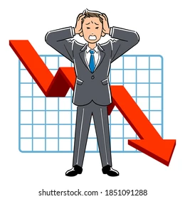
Why is Drift Important?
Expectability. If your model was trained and tested on different data from the production data, how can you guarantee its behavior?
Performance. Drifted production data commonly mean deterioration in performance.
Data Drift: when weak model segments become more prominent.
Concept Drift: The model’s previously accurate predictions become false.
Notes:
There are many reason but In My Opinion two stands out: …
Expectability: A Key requirement of company stakeholders before deploying a model to production is trust. You need to be able to guarantee the model approximate behaviour across different metrics and data segments
Performance: deterioration in performance,
Based on the example from before (model is bad on small apartments, different predictions for penthouses)

Slide 18
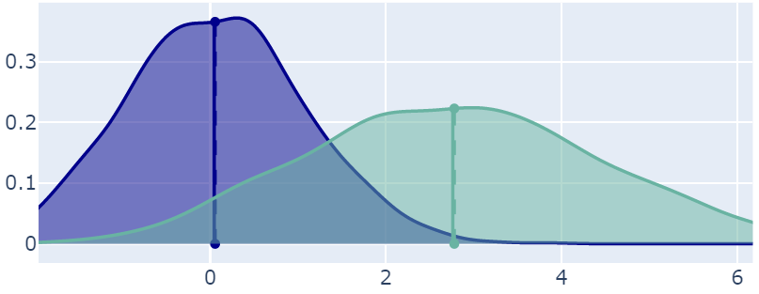
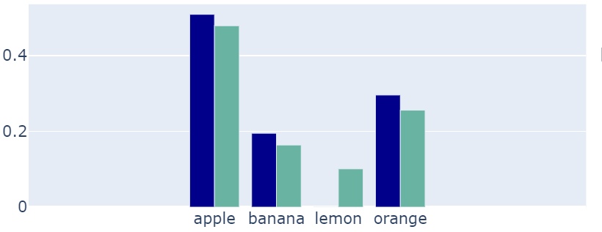
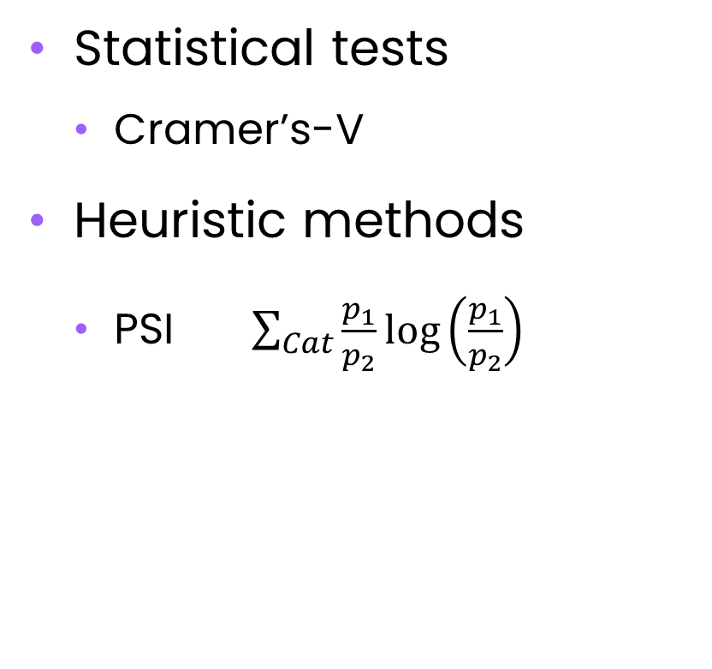
Detecting Drift – Univariate
Numeric
Categorical
Statistical tests
Kolmogorov-Smirnov
Distance metrics
Earth Movers
Statistical tests
Cramer’s-V
Heuristic methods
PSI $\sum_{Cat}{\frac{p_{1}}{p_{2}}}\log\left(\frac{p_{1}}{p_{2}}\right)$
Notes:
Explain with an simple example - we are a company that buys and sells houses and have a model that get a house details and predicts its cost.
Data Drift: over time we get a lot more small apartments then before (less private houses, big apartments)
Concept Drift: Penthouse apartments become popular and the relative cost of them soars

Slide 19
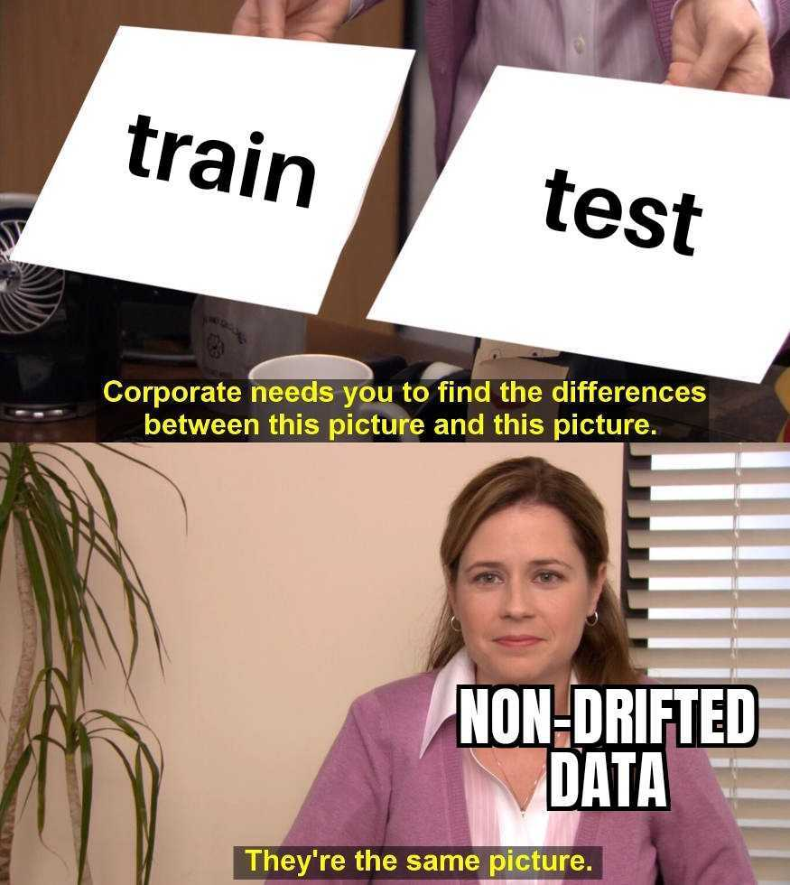
Detecting Drift – Multi-Feature
“Domain Classifier” / “Adversarial Validation”
Train a model to tell train and test apart

Slide 20
Detecting Drift in Unstructured Data

Slide 21
Data & Model Validations
Integrity
Distribution & Performance
Keep unstructured
Transform to structured
Sticky keysssss
Gibberish
Sample leakage
Drift Detection
Shortcuts
Weak Segments
Notes:
Main difference : The need to generelize a group of samples

Slide 22



Transform The Problem
Metadata
Properties
Embeddings

Slide 23

Metadata
Metadata is any information that can be collected from external source on the text sample.
information on the person who wrote the text
details on the when and where it was published
what effect the text had.
Notes:
In the example embedding were calculated for different books (each book in a sample) then TSNE was applied to reduce it into 2-dim

Slide 24



Properties
Any information that can be derived from the text
Technical:
Text length, average word length, number of special chars, TF-IDF
Linguistic:
Language, number of nouns
Domain specific:
Sentiment, register, topic
Notes:
Properties are just feature extractions

Slide 25
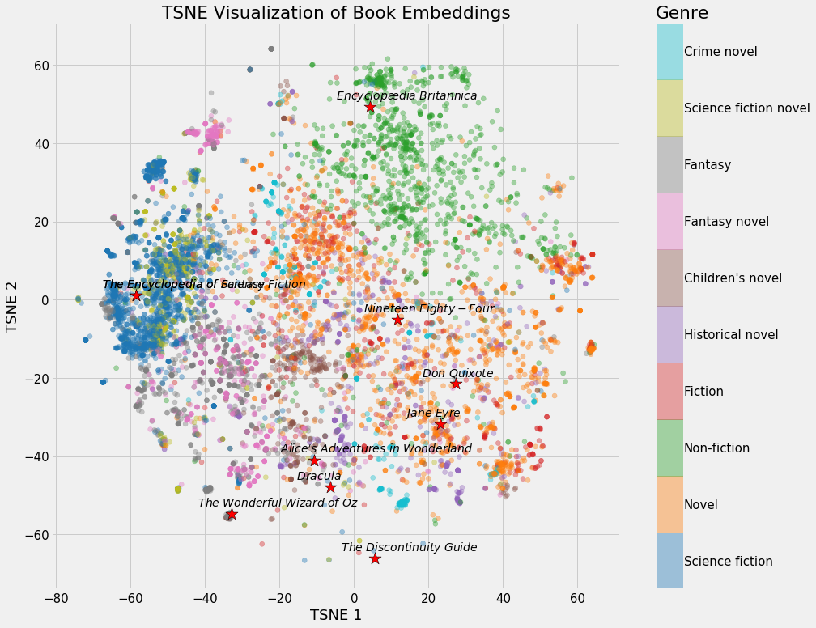
Embeddings
Embeddings are a low-dimensional continuous vector representation of a sample. Quality embedding capture the essence of a sample such that semantically similar samples will have similar embedding vectors.
In the context of neural networks, usually one of the final model layers are used as the embedding.
Notes:
In the example embedding were calculated for different books (each book in a sample) then TSNE was applied to reduce it into 2-dim

Slide 26
Transform The Problem
Metadata
Properties
Embeddings
Accurate
Good for segmentation
Not always available
Doesn’t describe the text
Less accurate
Good for drift and outliers
Depends on domain
Describes the text
Accurate
Good for drift and outliers
Low explainability
Describes the text
Notes:
Little bit about the pros and cons of each method
Embedding have bad explainability – bad for root cause analysis and followup mitigation

Slide 27
Drift Mitigation
Reduce the amount of drift. This can be achieved by:
Removing features / samples from the train set.
Adding synthetic examples to train set (ex. by using data augmentations, SMOTE).
Informed modelling. Select a model and a training procedure that takes into account the drift in the setting. One example is to up-weight train samples in regions that are more prominent in the test set.
Both methods require access to the drifted production data and finding both the cause for the drift and relevant train samples / regions for mitigation.
Notes:
Two main approaches
Possible (and recommended) to combine several such techniques
Important to re-check for drift after applying the mitigation to see we have not created drift in a different place

Slide 28

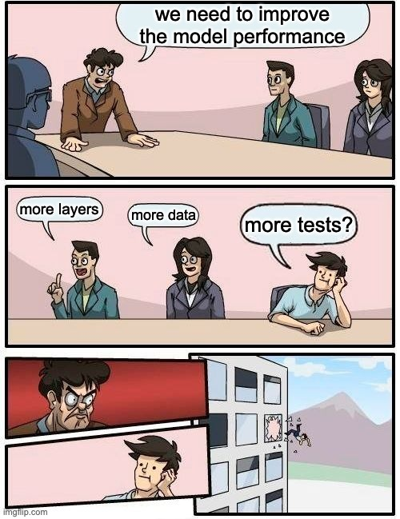
Thank you for listening, and may the tests be with you
https://github.com/deepchecks/deepchecks
👂 Feedback, ideas & feature requests are greatly appreciated! 🙏 and if you like what we’re doing – give us a ⭐ on GitHub
Notes:
Hope you found this talk informative! The presentation as well as the code presented are available online.
For those of you who will use the deepchecks package I encourage you to give us feedback and suggestions on how to improve.
Also, Feel free to contact me if you have any questions. Thank you for listening and good luck in the challenge!

Slide 29

Hands On Session

